Slide 1
PGCE History Mentors’ Meeting

Slide 2
Most importantly…
Notes:
The trainees simply could not have done this year without you – your knowledge, skilfulness, wisdom, care, patience and hope, was crucial to a large number of them making it to QTS this year. And a huge personal thank you for keeping me going, when there were just too many people melting down at once – you made what can sometimes be a lonely role possible. There has been a lot of dismal this academic year, so let’s take a moment to congratulate ourselves for launching some super new history teachers despite it all.

Slide 3
Today’s meeting – about an hour
Record!
DfE Consultation re ITE
Ofsted and the Core Content Framework
The shape of the year
Support for your role
Building a mentoring culture
Other news

Slide 4
DfE Consultation
Subject-specific teacher education?
Partnership working for a local area?
Curriculum autonomy?
Notes:
A small number of accredited providers - Government approved single, approved model of teacher training. Accredited providers sub-contract to ‘delivery partners’.
A single curriculum and curriculum structure (sequence) – curriculum developed centrally.
Control – short-termism.
PLEASE respond to the consultation – it will be end of July, beginning of August – show this page - https://www.history.org.uk/ha-news/news/3983/initial-teacher-training-market-review-consultation In this form this endangers all we do as a partnership and also takes out initiatives such as YorkClio, History Nerds etc.
Cog Sci EEF systematic review: https://twitter.com/DamsonEd/status/1413168492757635078?s=20 and https://www.youtube.com/watch?v=BXzjXkMaePM and Ofsted’s review of Secondary History has landed today: https://www.gov.uk/government/publications/research-review-series-history
https://www.teachbest.education/

Slide 5
Ofsted
Core Content Framework
Work with a partner
Open the G-Doc link in Chat
Type examples of how you support trainees to ‘learn how to’ for your ‘S’ onto the G-Doc
Add to other ‘Ss’ if you have time
Notes:
January onwards – and early signs are that everything is oddly fixated around the Core Content Framework. On the one hand we are told it is just part of ITE and that it is not an assessment model, on the other hand, all the Ofsted teams this term have fixated on it. Although QTS is gained by assessment vs the Teachers’ Standards, inspectors this term have been suggesting that they should not be mentioned until the end!
I have sent you the CCF on the e-mail. When we get the call, please scan it. And above all, have confidence. Ruth and I have been working with it for over a year now and we are convinced we are doing everything, so please don’t be alarmed, but do be au fait with it.
G-Doc: https://docs.google.com/document/d/1A5TUhn2XG0fPUgUkFtB0mEKwHpraRJpRZGQtXcexlfI/edit

Slide 6
2021-22: Plan A!
Induction Week starts 13th September
Trainees in school Tuesday and Thursday from 21st September to 21st October – Assignment One
Placement One Block One: Tuesday 2nd November to Friday 10th December – Review One
8-12 full and deliberate lessons – lots of other parts – observations - mentor-trainee shared reading – reading for Assignment Two – subject knowledge work – teacher talk peer project
Placement Two Block Two from Monday 10th January to Friday 4th February – Assignment Two and Review Two
work up to 50% timetable - subject knowledge work – mentor-trainee shared reading – Assignment Two
Visits to Placement Two School: Tuesday 8th and Thursday 10th February
Placement Two from Monday 14th February to Friday 20th May – Review 3 (25th March), Univ Recall Day (25th March), Review 4 (13th May), Assignment Three. + SD Days
Work back up to 50% quickly – up to 70/80% by last two weeks - Assignment three – trainee-mentor shared discussions
Notes:
Will of course repeat this across year – are the regular weekly mails from me helpful in terms of right info, right time, right length??
How has Pebblepad worked?
Please remember:
You have a crucial role in drawing them back to what they have learnt in first part of course re history, and in developing reflection. P1 shared reading and P2 discussion topics are part of that
Detailed lessons plan and evaluation in P1 Block 1. If they are flying can then start to see if can internalise planning, but if in any doubt, or a new class then use the written plans. (Let’s keep a trainee specific and responsive approach. – Never listen to ‘but univ says…’!)
Subject specific targets
Chance to mark and give feedback – including ghost marking GCSE/A level in P1
A level experience – must be in P1 if you are an 11-18 school
As much in department and local network activities as you can (YorkClio, Nerds etc)
Note re paired placements (as opposed to two trainees in dept) – trainees some solo classes and some classes they work as a team together to teach (the Y model) – they can observe each other, collaboratively teach/plan/assess/develop resources, work cross-cirrucular. Can teach with 1 as lead and other as TA, or team teach, or split class, offer 1:1 to pupils, specific work with higher/lower attainers, , support each other’s subject knowledge, building prof relationships etc.

Slide 7
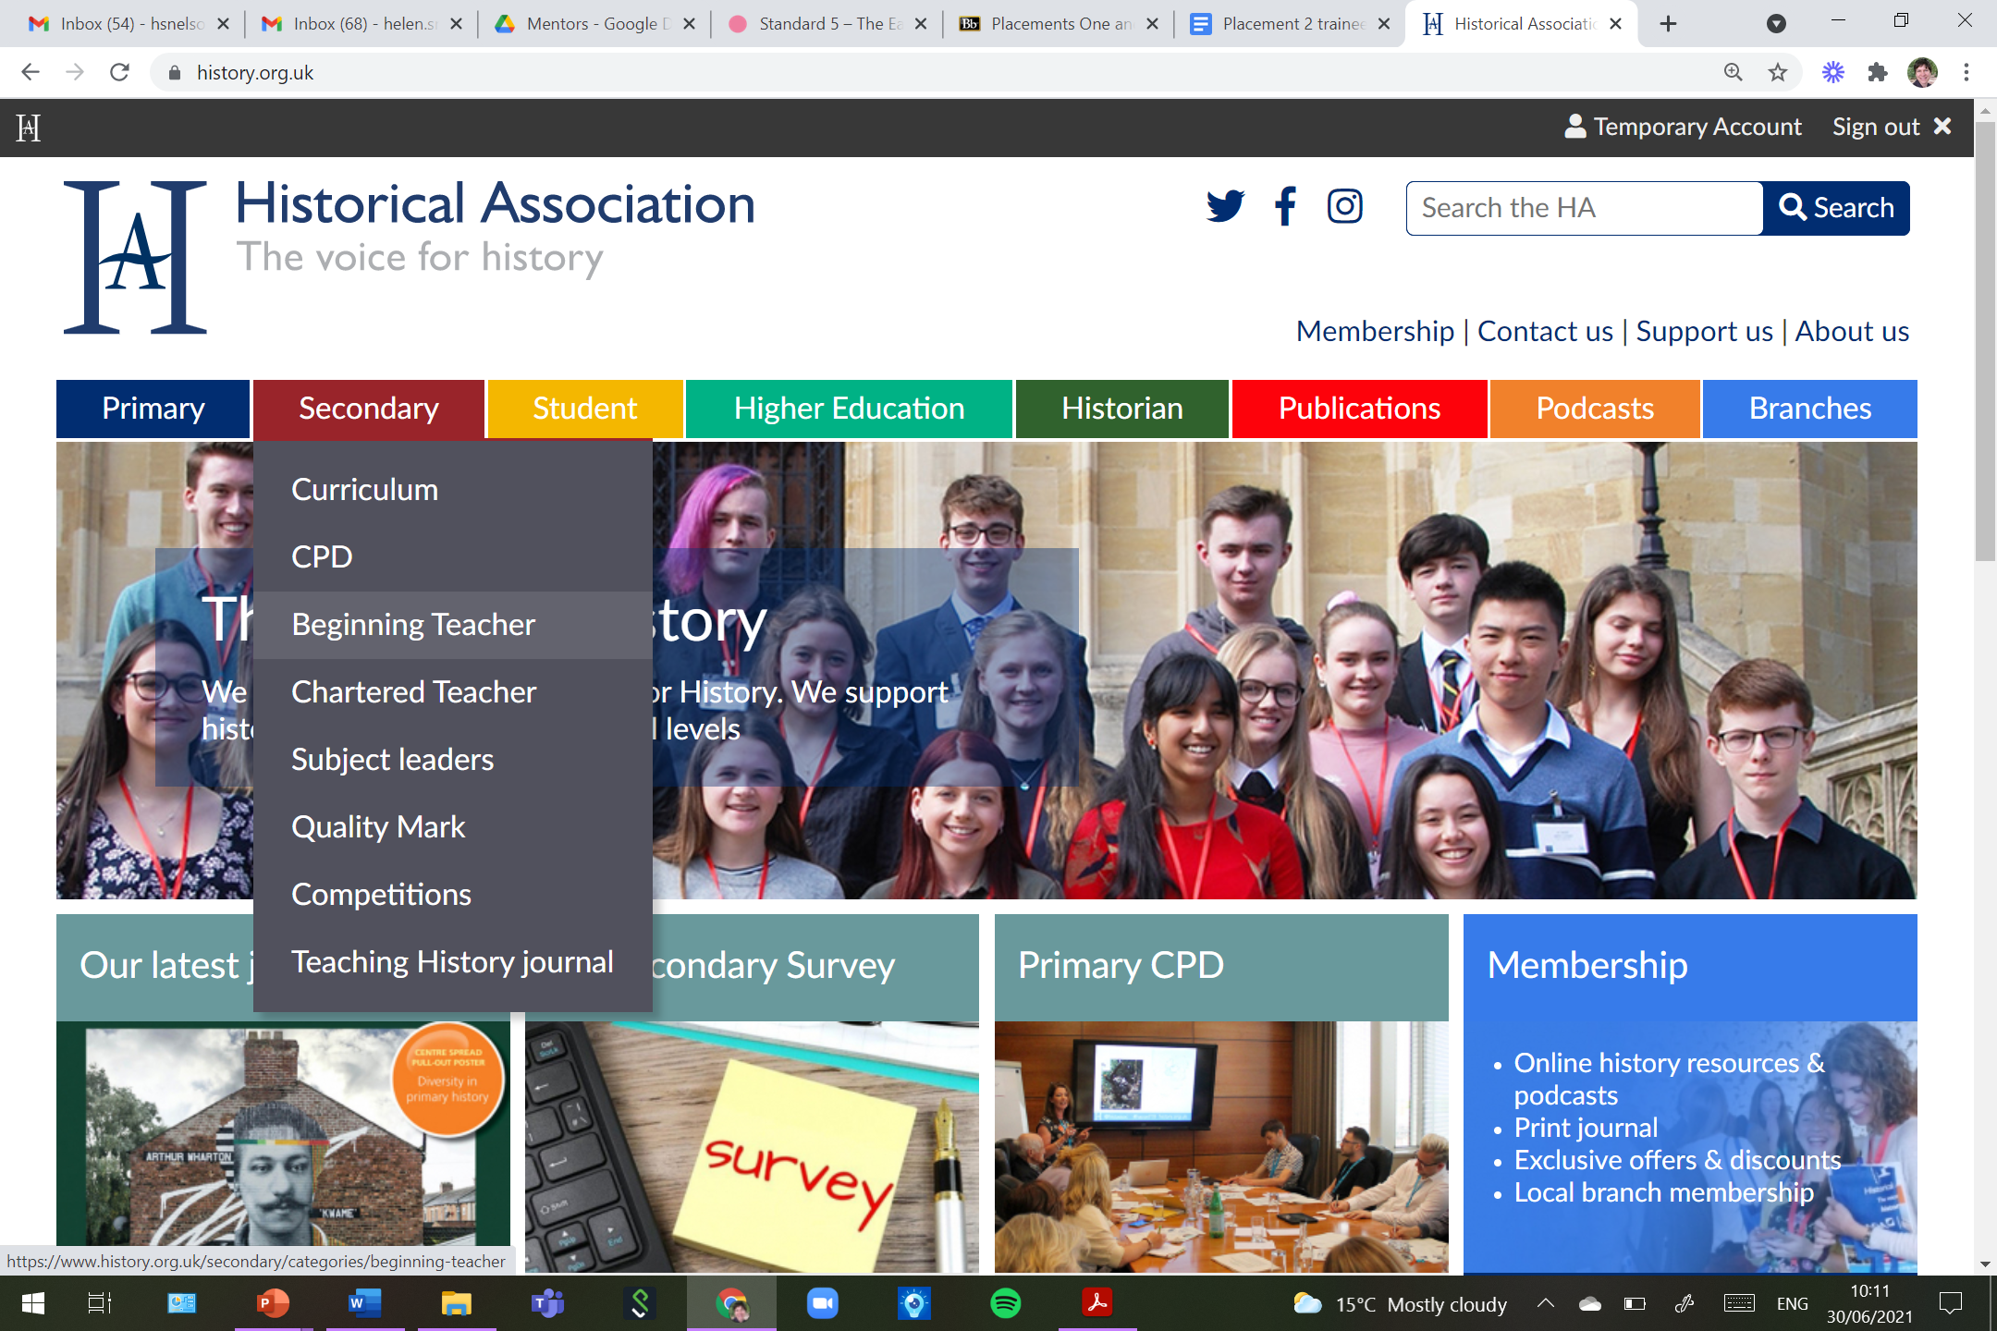
Support for your role
https://www.history.org.uk/secondary/categories/380/module/8763/teaching-for-beginners
Notes:
As well as Ruth and I!
https://www.history.org.uk/secondary/categories/380/module/8763/teaching-for-beginners
If a trainee has a specific issue or a strength to build on and you are short of time too – this may help.

Slide 8
Building a mentoring culture
Planning together moments
Draw on trainees’ expertise
Assignment Three
Model learning
Do CPD together
Part of department
“A culture of mutual support, craftsmanship, intellectual excitement and growth.”
Notes:
Drawing out some of the hallmarks of mentoring culture that we see in spades across the partnership. As we (hopefully) get back to more normal, to regroup and reboot…
Planning together – please let trainees see you wrestling with your own planning as a department, include them in discussions about new units, sequences and help them to see how you plan the big picture together so that everyone has a curricular understanding.
Trainees expertise – they have recently done degrees and they have sat in our CA sessions – is there a topic on your spec that they are a subject knowledge expert in from their dissertation? They could take a section of dept meeting to update the dept on more recent scholarship and historical debate relating to that topic.
Assignment Three – it’s about a small piece of practitioner investigation – what are your department interested in? Can that marry with the trainee’s interest. They could then do the literature review for you before Easter and carry out a small investigation on a topic that might support departmental development?
Model learning – make it clear you are wrestling with how to teach too, model always learning, discuss, puzzle, wrestle with history and history teaching in front of them. It can be really reassuring to them to see experts also struggle sometimes and also it’s about getting them to realise they will not know it all after a 9 month PGCE.
Do CPD together – take trainees to YorkClio meetings and discuss, listen to a podcast and discuss it, all read the same history book, go to HA etc webinars/ forums/conference together.
Part of dept – have lunch altogether, eat cake – drink coffee – expect them to contribute!
Focus on micro-curricular decisions.
UoY team is here to support trainees – mentors – subject depts in partnership – both us, but also links into the university Education and History and wider – feel free to use!

Slide 9
Other news…
February mentors’ meeting
Course development + CPD
YorkClio 2021-22 (https://yorkclio.com)
Sept: Y6 into Y7 – what should they be able to do – the primary perspective (F2F)
Jan: Mike Hill (Zoom)
June: Y6 into Y7 – what should they be able to do – the secondary perspective (F2F)
History Nerds 2021-22 (https://bit.ly/YorkClioHistoryNerds)
November: HA Great Debate
February: Dr Helen Lacey, UofOxford, 'People of 1381’ - old docs, big data, new interpretations
June: Dr Ian Milstead, YAT, uncovering Eboracum – with a skeleton!
Wider…
https://www.history.org.uk/secondary/categories/whats-on for subject leader programme, webinars on early career mentoring, teaching reading and writing, globalizing the World Wars, historians, virtual branches. SHP online conference coming up at the start of July.
onebighistorydepartment.com

Slide 10
Please…
Respond to the DfE ITE consultation
Keep the Core Content Framework to hand next year
Focus on history and history teaching
Have confidence in what we do
Have a wonderful and relaxing summer!

